Slide 1
C++ Programming:
Problem Solving and Programming
Chapter 6
Repetition

Slide 2
Objectives
In this chapter you will:
Learn about repetition (looping) control structures
Explore how to construct and use count-controlled, sentinel-controlled, flag-controlled, and EOF-controlled repetition structures
Examine break and continue statements
Discover how to form and use nested control structures

Slide 3

Concept of Looping
A loop is a group of instructions the computer executes repeatedly while some looping continuation condition remain TRUE.

Slide 4


Slide 5
Pre-Test Loop
The condition is checked at the beginning of each iteration (loop)
Condition
false
true
Actions

Slide 6
Pre-Test Loop
In each iteration (loop), the condition is tested first.
If it is TRUE, the loop continues. Otherwise, the loop terminates.
This structure is possible not executing any actions at all.
Condition
false
true
Actions

Slide 7
Pre-Test Loop
Example:
Set ball counter to 0
While box is not empty
Take a ball from box
Increase ball counter by 1
End While
Print ball counter

Slide 8
Post-test Loop
The condition is checked at the end of each loop
Actions
true
Condition
false

Slide 9
Post-test Loop
In each loop, the loop actions are executed. Then the condition is tested.
If it is TRUE, a new loop starts. Otherwise, the loop terminates
This structure performs the actions at least once.
Actions
true
Condition
false

Slide 10
Post-test Loop
Example:
Set ball counter to 0
Do
Take a ball from box
Increase ball counter by 1
While box is not empty
Print ball counter

Slide 11
Exercise
Based on the general algorithms above, what will happen to each type of loops if the box is initially empty?

Slide 12
Loop Condition, Initialization & Update
Other than condition, commonly there are 2 more processes (initialization and updating) associate with loops.

Slide 13
Loop Condition, Initialization & Update
Initialization
Set student counter = 1
While student counter <= 3
Print “Congratulation”
Add 1 to student counter
End While
Condition
Action
Print “You are late”
Updating
This loop will repeat for 3 times

Slide 14
Loop Condition, Initialization & Update
Notes:
It is important to write your initialization, condition and updating statements correctly. If not, the loop will either never repeat or never stop (i.e. an endless loop).

Slide 15


Slide 16
Event-Controlled Loop
The loop will be terminated when an event changes the loop control expression (condition) from TRUE to FALSE.

Slide 17
Event-Controlled Loop
Set total to 0
Do
Read number
Add number to total
Print “Anymore (Yes/No)?”
Read response
While response = “Yes”
Print total
This loop keeps repeating as long as the user response is “Yes”.
Event: The user response.

Slide 18
Counter-Controlled Loop
Used when we know the number of times action(s) are being repeated.
In this case, we will use a variable as a counter to repeat the action(s).

Slide 19
Counter-Controlled Loop
Initialize the control variable (student counter).
Set student counter = 1
While student counter <= 3
Print “Congratulation”
Add 1 to student counter
End While
Print “You are late”
Condition tests the value of the control variable.
Update the control variable.

Slide 20
Looping Control Structures
3 types:
  while loops
  for loops
  do-while loops

Slide 21
while loops
It is a pre-test and
event-controlled loop.
Action is run repeatedly
while the condition is true
Syntax:
Condition
false
true
Actions
while (condition)
{
action
}
The braces { and } can be ignored if there is only 1 statement in the body of a while loop.

Slide 22
while loop - Example
Write a program that finds the value of 2 multiply itself 10 times by using a while statement.

Slide 23
while loop - Example
#include <iostream>
using namespace std;
int main()
{
int x = 2;
int count = 1;
while (count <= 10)
{
x = x * 2;
count++;
}
cout << "The result is “<< x;
return 0; }
Initialization
Condition
Updating

Slide 24
while loop – Exercise
Write a loop to print out the even numbers from 500 to 2.
Algorithm
set counter to 500
while counter >= 2
print counter value
subtract 2 from counter
end while
Answer:
int i=500; while(i>=2) { cout << i << endl; i-=2; }

Slide 25
while loop – Exercise
Answer:
int x=2, count=1, sum=0; double average; while(x<=10) { sum = sum + x; x+=2; // same as x=x+2; count += 1; } average = sum / count; cout <<“ sum: ”<<sum << endl; cout << “average:”<<average;
Write a loop to print the sum and average of even numbers from 2 to 10.

Slide 26
Sentinel Value
Sentinel value is a special value that causes a loop to stop
It cannot confuse with the valid value, example: -999 for a test score
Used when user may not know how many values to be entered during input process

Slide 27
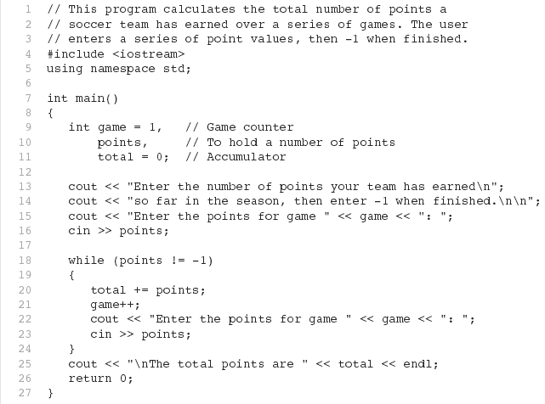
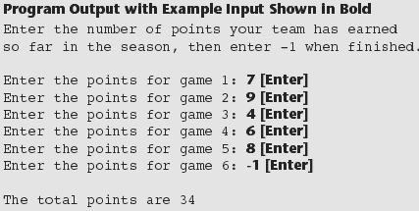
Sentinel Value - Example
AACS2524 Programming Concepts

Slide 28
for loop
It is a pre-test and
counter-controlled loop
Syntax :
expr1
(Initialization)
expr2
(Condition)
False
Initialization
Condition
True
for ( expr1; expr2; expr3 )
{
action
}
Action
expr3
(condition)
Updating

Slide 29
for loop
A for loop contains 3 major components:
  expr1: Initialization of control variable.
  expr2: Loop continuation condition.
  expr3: Updating (increment / decrement) of control variable.

Slide 30
for loop is equivalent to while loop
for (expr1; expr2; expr3)
{
action
}
Used when a loop is to be executed a known / fixed number of times. We can do the same thing with a while loop, but the for loop is easier to read and more natural for counter-controlled loops.
expr1;
while (expr2)
{
action;
expr3;
}

Slide 31
for loop is equivalent to
while loop
for loop | while loop
for (i = 1; i <= 10; i++) { cout << i; } | i = 1; while (i <= 10) { cout << i; i++; }

Slide 32
for loop
The empty for statement causes an endless loop
for ( ; ; )
{
action;
}
The loop can start but no condition tells when to end the loop

Slide 33
for loop - Exercise
Write a for loop to print the following integers in sequence:
5 10 15 20 25 30 35 40 45 50
Answer:
for ( i = 5; i <= 50, i+=5 ) cout << i << ‘ ’;

Slide 34
for loop - Exercise
Write a program that reads a number, and use a for loop to display series of integers from 1 up to the number. The output should be:
Answer:
int limit; cout << “Please enter the limit : "; cin << limit; for (i = 1; i <= limit; i++) { cout << i << endl; }
Please enter the limit : 3
1
2
3

Slide 35
do-while loop
It is a post-test and event-controlled loop.
If you want the loop’s body to execute at least 1 time, you can use a do-while loop.
do
{
action;
} while (condition);
Actions
true
Condition
false

Slide 36
do-while loop – Exercise
Convert the following loops to do-while loops. The output should remain the same.
(a) Print the square of integers 1 to 10 inclusive.
number = 1;
while (number <= 10)
{
square = number * number;
cout << square << ‘ ’;
number++;
}

Slide 37
do-while loop – Exercise
Answer:
number = 1; do { square = number * number; cout << square << ‘ ’; number ++; } while (number <= 10);

Slide 38
do-while loop – Exercise
(b) Print all multiple of 3 in between 10 to 90 inclusive.
for (num = 10; num <= 90; num++)
{
if (num % 3 == 0)
{
cout << num << ‘ ’;
}
}

Slide 39
do-while loop – Exercise
Answer:
num = 10; do { if (num % 3 == 0) cout << num << ‘ ’; num ++; } while (num <= 90);

Slide 40
Loop used to
Accumulate Total
An accumulator is a variable that you use to gather or accumulate values.
Important: Accumulator has initial value. Usually it starts with 0.
Total Sales
Product 1: 120
Product 2: 250
Product 3: 360
Product 4: 99
Total: 829

Slide 41
Loop used to
Accumulate Total
Example:
int total = 0, price;
for(int i = 0; i<4; i++)
{
cout << "Product " << i+1 << ": -> ";
cin >> price;
total = total + price;
}
cout << "\n\nTotal: " << total << endl;
accumulator

Slide 42
Nested Loop
Loop within a loop.
Program logic gets more complicated.
When there is a nested loop, for each iteration of the outer loop, the inner loop is entered and repeated until done before the next outer loop is entered.

Slide 43
Nested Loop - Example
for(i=0; i<3; i++)
{
cout<<“i=”<<i<<‘: ’;
for(j=1; j<=5; j++)
cout << j;
cout << endl;
}
Output:
i=0: 1 2 3 4 5
i=1: 1 2 3 4 5
i=2: 1 2 3 4 5

Slide 44
Nested Loop – Exercise
Use nested for loop to
print the pattern below:
@@@@@
@@@@@
@@@@@
@@@@@
Answer:
for (i = 0; i <= 3; i++) { for (j = 0; j <= 4; j++) cout << ‘@’; cout << endl; }

Slide 45
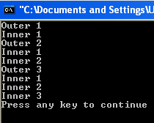
Nested Loop – Exercise
Without using the aid of computer, produce the output of the following code:
int i, j;
for (i = 1; i <= 3; i++)
{
cout<<"Outer “<<i<<endl;
for (j = 1; j <= i; j++)
{
cout<<"Inner “<<j;
cout<<endl;
}
}

Slide 46
Nested Loop – Exercise
What is the output for the following code?
for(int x = 0; x < 4; x++)
{
for(int y = 0; y <= x; y++)
{
cout << “+” ;
}
cout << endl;
}

Slide 47
Jump Statements
To terminate the loop or skip some statements within a loop when certain condition is TRUE.
Some controls of loop execution are needed.
2 types of jump statements:
    break statement
    continue statement

Slide 48
break statement
Causes immediate exit from the structure .
Program execution continues with the first statement after the structure.
It can be used in
  while loop
  for loop
  do-while loop
  switch statement

Slide 49

break statement - Example
int x;
for (x = 1; x <= 10; x++)
{
if (x == 5)
break;
cout << x;
}
cout<<“\nLoop ended at ”<<x<<“\n”;

Slide 50
continue statement
A continue statement will skip any remaining statements in the body of the structure and proceeds with the next iteration of the loop.
It can be used in
  while loop
  for loop
  do-while loop

Slide 51

continue statement - Example
int x;
for (x = 1; x <= 10; x++)
{
if (x == 5)
continue;
cout << x;
}
cout<<“\nLoop ended at ”<<x<<“\n”;

